Slide 1


Introduction
Zillow’s Zestimate is a home evaluation real estate based in the U.S.A.
The company has been in operation for the last 11 years. Since then, the company has been giving consumers insights related to the market prices of houses in the market. Therefore, the company has become one of the largest and most trusted marketplaces for real estate information in the U.S.A.
As part of the student learning, data from the company was used to understand the application of the multiplication regression model in the real-world context.

Slide 2

Project Goal
The goal of the project is to apply multiple regression model to accurately predict the price of house based on the following predictor variables:
Lot area/size in square feet
Overall quality (overall material and finish of the house)
Year Built (original construction date)
Year remod Add (remodel date)
BsmtFinSF1 (finished square feet)
FullBath-Full bathrooms
Notes:
Amazon has implemented various Six Sigma techniques, including attracting the best innovators from selective elite colleges like MIT and Carnegie-Mellon, to help the Procedure gel even better. Since the process is only as effective as the person driving it, it really is critical that the talent employed understands what they are doing.

Slide 3
Project Goal Cont…
HalfBath-Half baths
BedroomAbvGr: Number of Bedrooms above the ground
TotRmsAbvGrd: Number of rooms above the ground
Fireplaces: Number of fireplaces
GarageArea: Size of garage in square feet
YrSold: Year sold
Notes:
To maintain a superior standard of service, the corporation commits more staff to its shipping and customer service offices than to its engineering department. Amazon was try to optimize resources available while lowering expenses by taking this method. Notably, it is a wise decision to safeguard a company against imprudent expansion.

Slide 4
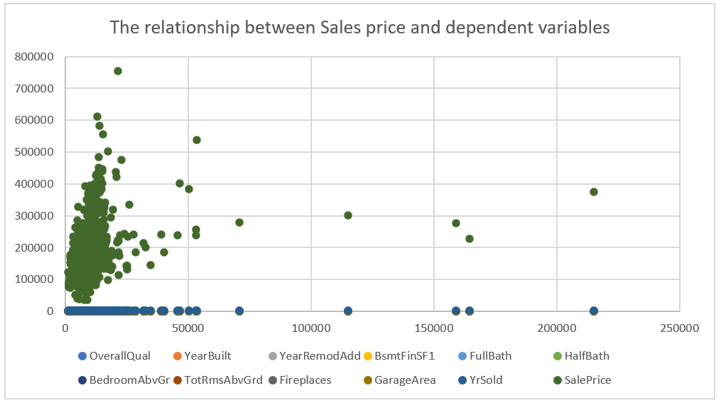
Data Exploration and Analysis
Before the analysis, the data was explored for linearity assumptions using scatter plot as shown in figure 1 below. This revealed that there is a linear relationship between independent and dependent variables.

Slide 5
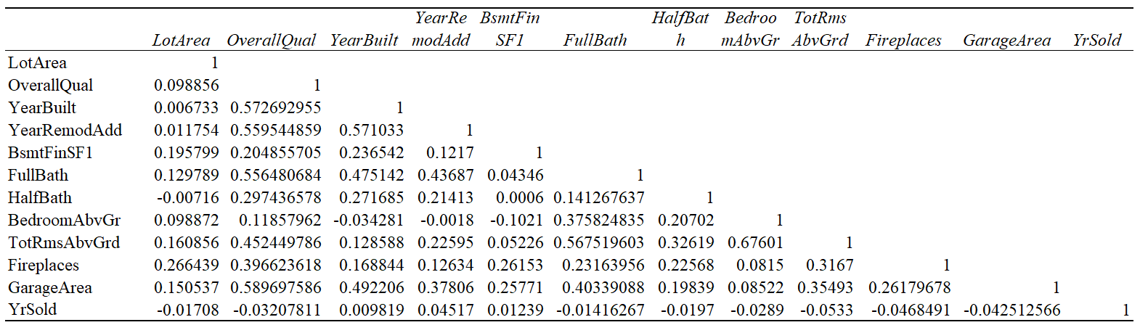
Data Exploration and Analysis Cont…
Secondly, multiple linear regression assumes that there is no multi collinearity among the independent variables. This was explored using the correlation matrix which revealed a correlation co-efficient of less than .80 as shown in table 2 below. To build an accurate regression model, it is recommended that the magnitude of the correlation among all independent variables should be less than .80

Slide 6
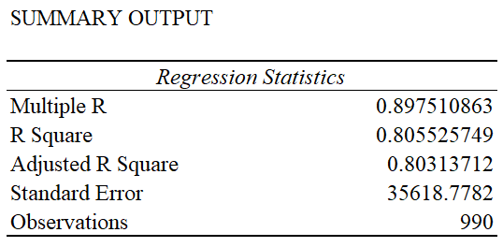
Regression Analysis Findings
R square revealed that 80.5% of the variability in Sales prices of the houses can be explained by the set of the independent variables in the study as shown in table 2 below.

Slide 7
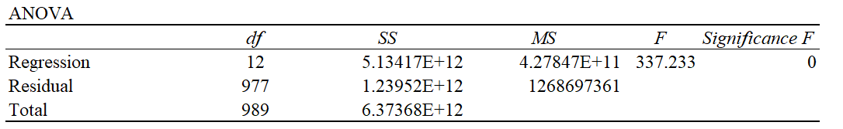
Regression Analysis Findings Cont…
The ANOVA table revealed significance F statistics that is lower than 0.5 significance level hence the test is significant.
Notes:
Amazon debuted its 8th generation distribution facilities in Europe 7 years ago, which integrate robotics, visual systems, and over two decades of software and technical breakthroughs to fulfill our customers' purchases. The technological system behind the implementation of Kaizen program for quality improvement is fascinating.

Slide 8
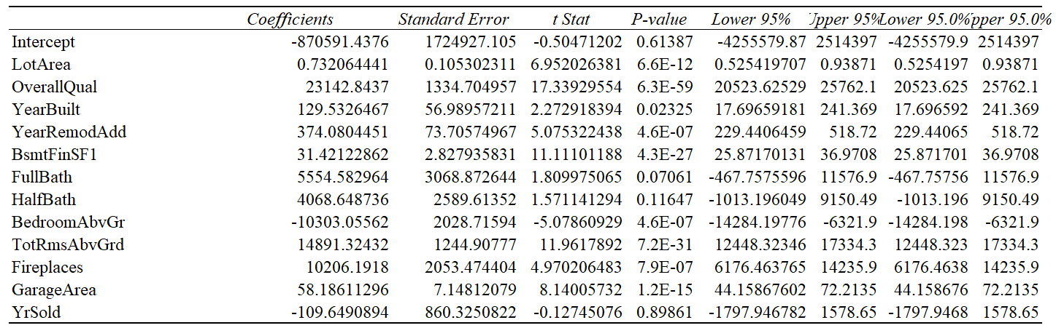
Regression Analysis Findings Cont…
The table shown shows the individual contributions of the independent variables on the house price. The table revealed that all the independent variables stated in the table except FullBath-Full bathrooms, HalfBath-Half baths and Year Sold have a significant contribution on sales price since their p values are less than 0.05.

Slide 9
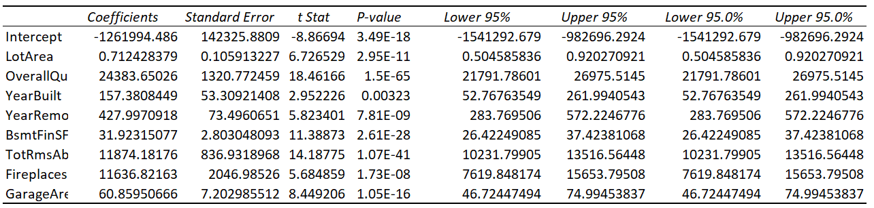
Predicting the house sales price
To predict the house sales price, only the independent variables with significant effect on the house sales price were be used for a regression model as shown in the presentation.

Slide 10
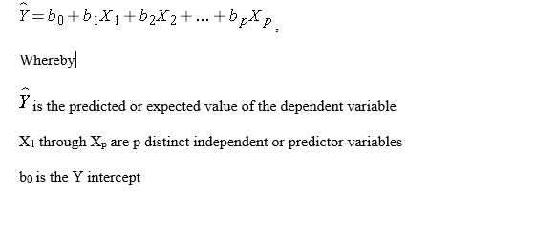
Predicting the house sales price Cont…

Slide 11
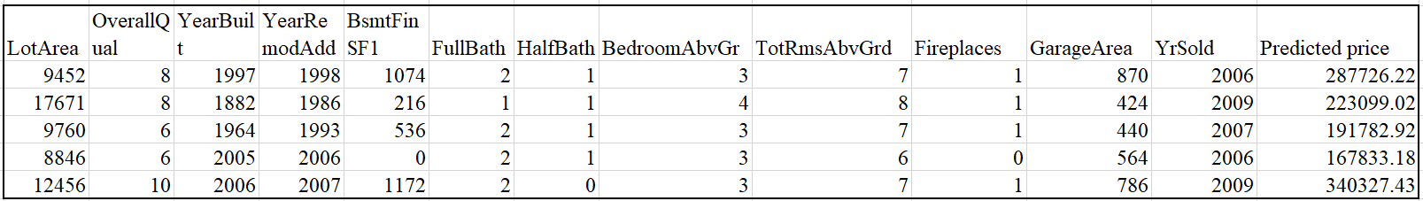
Predicting the house sales price Cont…

Slide 12
Conclusion
In Conclusion, the prices of the homes would increases based on lot area
However the prices of homes by year sold.
Garage area also affects the home prices drastically.

